Slide 1
Algorithmic methods for mathematical models
Manuel Breve & Nejada Karriqi
December, 2020

Slide 2
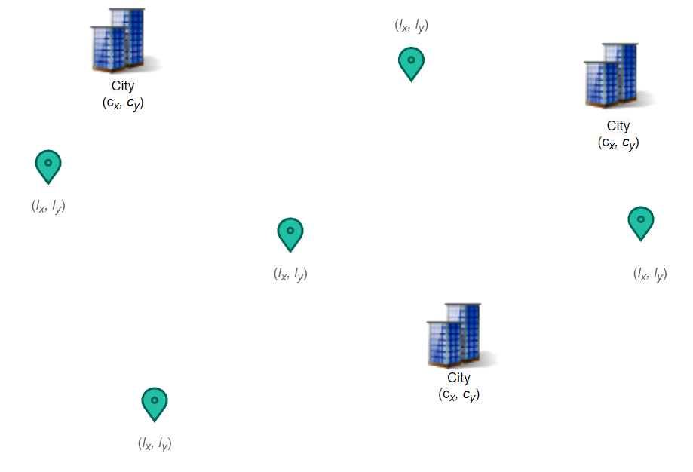
Problem definition

Slide 3
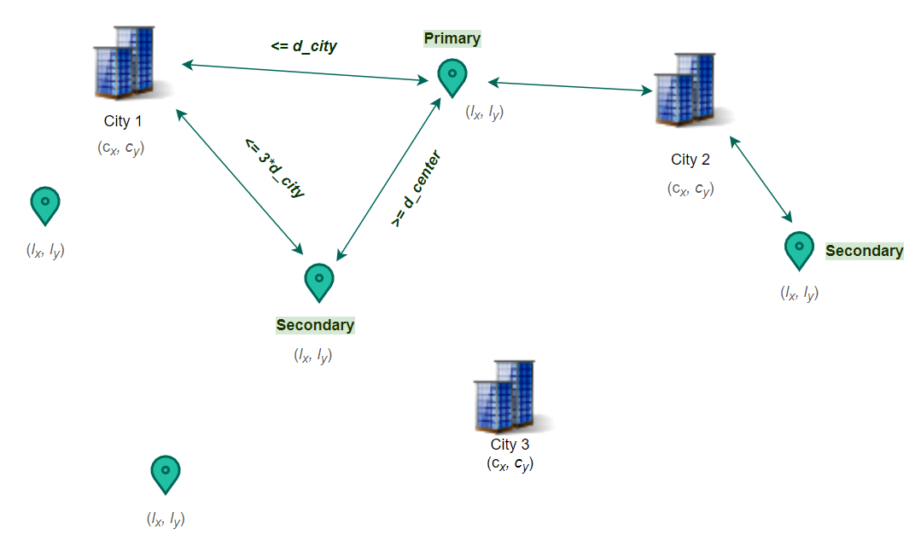
Constrains

Slide 4
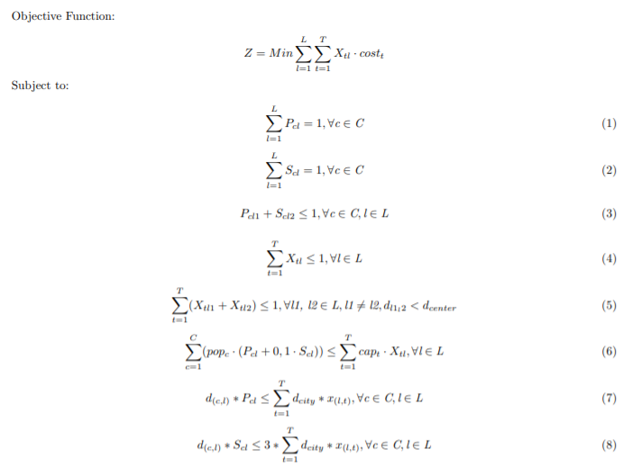
Mathematical Formulation
Notes:
Mention xtl, pcl, scl

Slide 5
Solution approaches
Integer linear programming model in OPL
(2) Heuristic algorithms
(a) Greedy constructive algorithm
(b) Greedy constructive + a local search procedure
(c) GRASP as a meta-heuristic algorithm

Slide 6
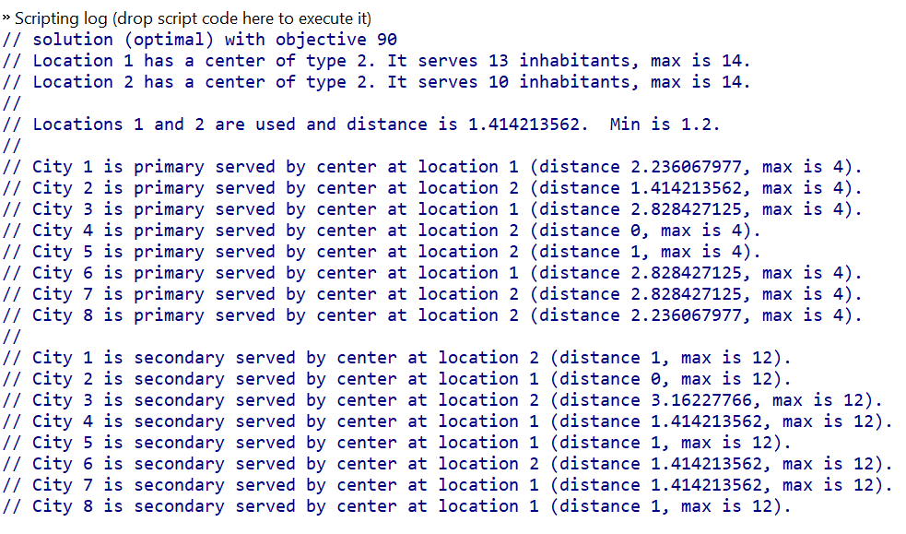
Cplex output

Slide 7
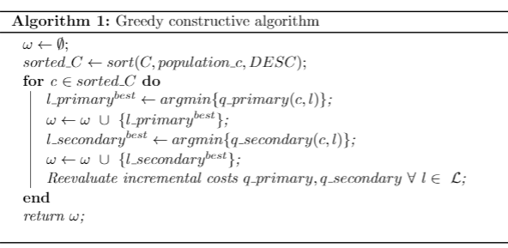
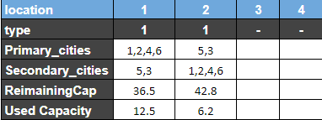
Greedy Constructive Algorithm
Cost: 94

Slide 8
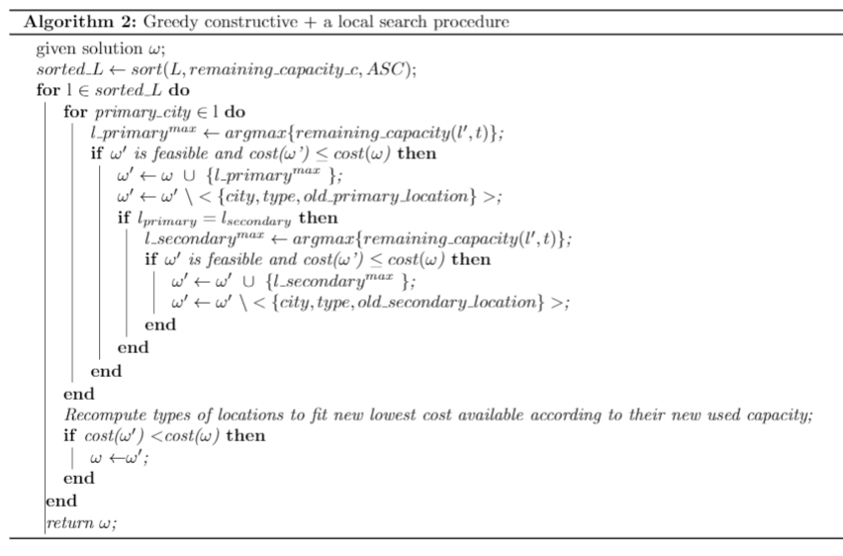
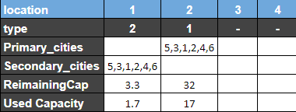
Greedy Constructive + Local Search procedure
Cost: 94
Cost: 90

Slide 9
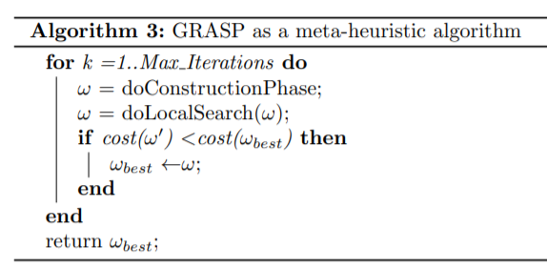
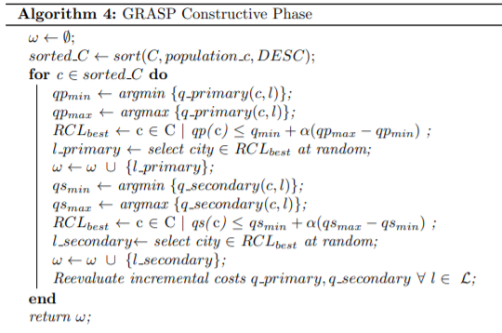
GRASP as a meta-heuristic algorithm

Slide 10
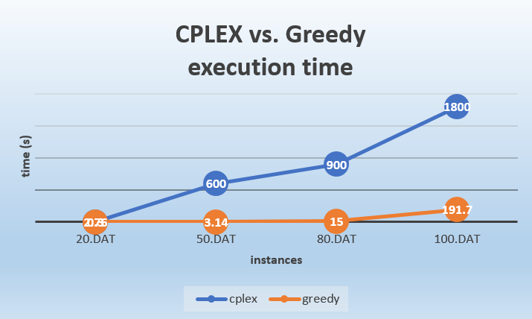

Slide 11
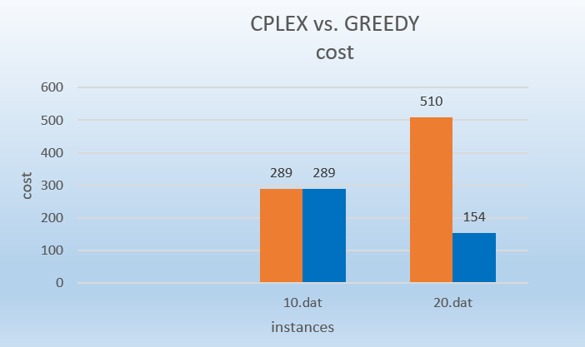

Slide 12
Conclusions
CPLEX finds only one optimal solutions, however with larger instances becomes slow.
Greedy algorithm performs better in computational time for large size problems, at the risk of high cost.
Local Search is suggested because it improves the Greedy initial solution.
GRASP should perform good computational time for small instances and poorly for larger ones.

Slide 13
Thank you
Manuel Breve & Nejada Karriqi
December, 2020

